Slide 1

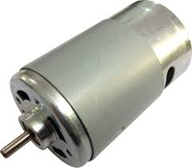
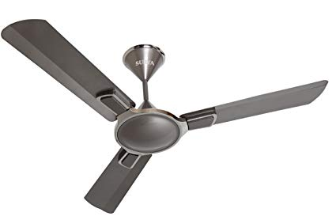

Real-life applications of DC motor
Fig.1.2 Fan
Credit: https://www.amazon.in/Surya-Royale-1200mm-Ceiling-Titanium/dp/B077NJV7HW
Fig.1.1 DC Motor
Credit: https://www.amazon.com/Small-Electric-DC-Motor-18000/dp/B00NLBXC6E
Fig.1.3 Refrigerator
Credit: https://www.ikea.com/us/en/p/nutid-french-door-refrigerator-stainless-steel-30377925/

Slide 2
Speed Control of DC Motor
Name: Wang Zihao Student Number:A0204706M Tutorial Group: 4b Date: 11th October 2019

Slide 3
OUTLINE
Principle behind DC motor
Ways of speed control
Comparison among ways of speed control

Slide 4
Definition of DC Motor:
DC motors convert electrical energy to mechanical energy, by using the force created by interacting magnetic fields

Slide 5
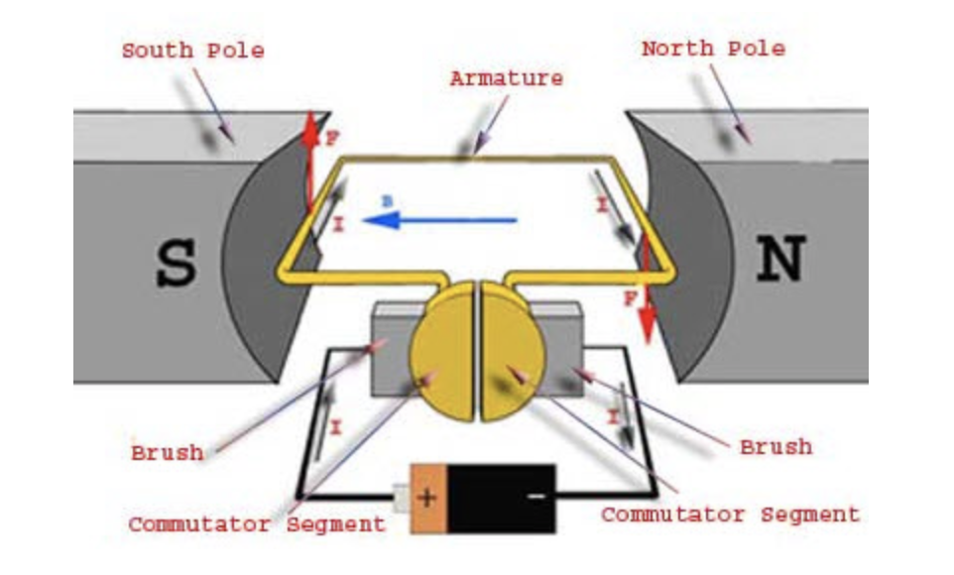
A DC motor contains mainly three parts
Fig.2.1 Side View of DC Motor
Credit: https://www.elprocus.com/what-are-the-best-ways-to-control-the-speed-of-dc-motor/

Slide 6
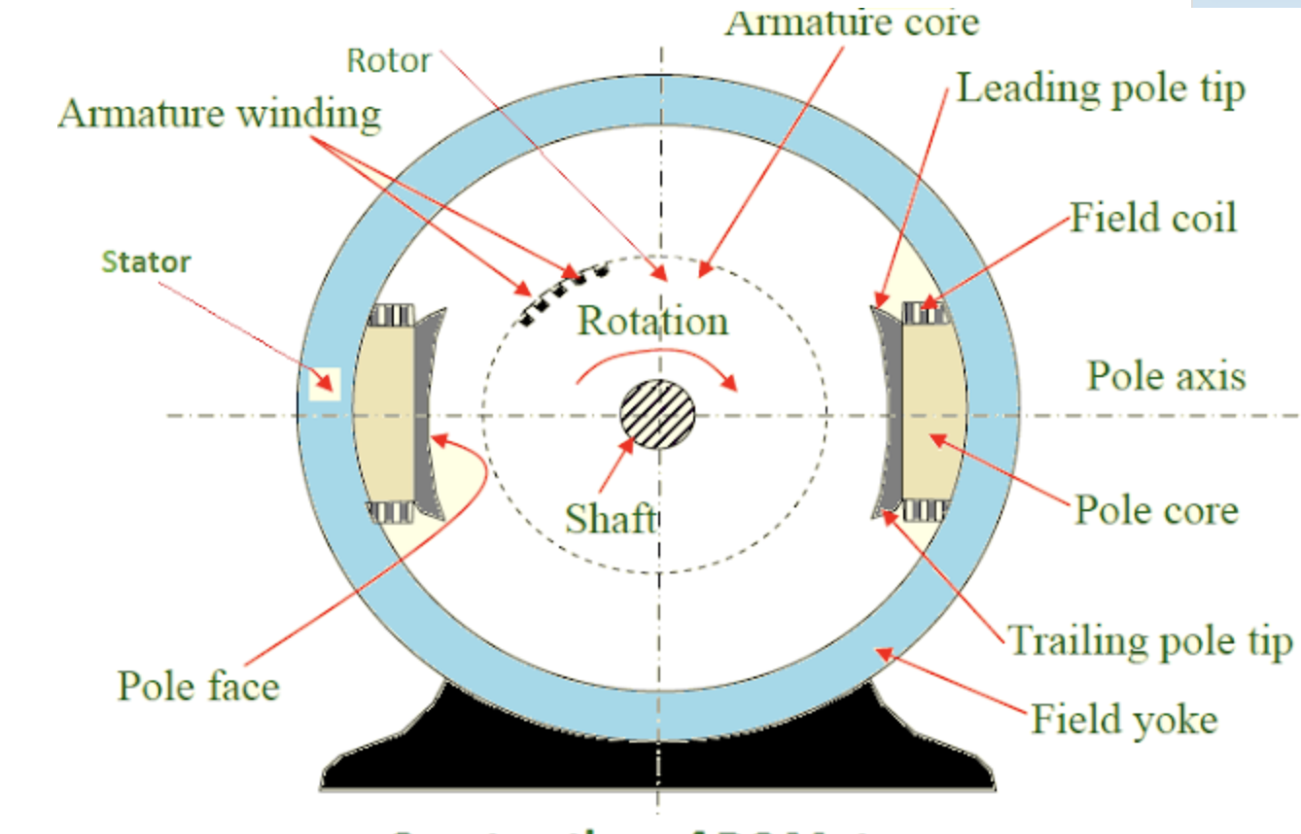
Armature winding and field coil are presented in a DC motor
Fleming’s Left Hand Rule
Faraday’s law of Induction
Fig.2.2 Cross Section of DC Motor
Credit: http://workingprincipalofdcmotor.blogspot.com/2013/01/construction-of-dc-motor.html

Slide 7

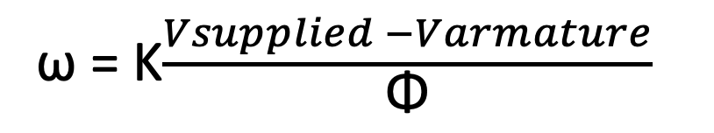
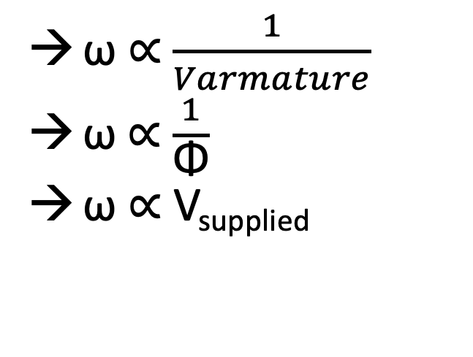
Three relationships related to angular speed can be derived
V_{supplied} = E_{b} + V_{armature}
&
Rearranging
ω = K$\frac{Vsupplied −Varmature}{\text{Φ}}$
ω ∝ $\frac{1}{Varmature}$
$\text{ω}$∝ $\frac{1}{\text{Φ}}$
ω ∝ V_{supplied}

Slide 8
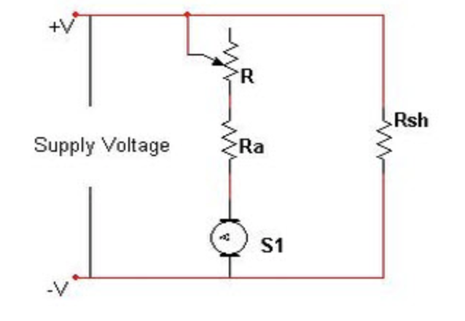
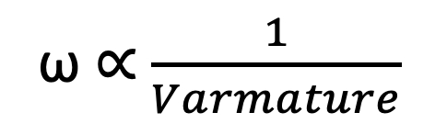
By varying the armature voltage, and by varying the armature resistance (i.e. Armature Control Method)
ω ∝ $\frac{1}{Varmature}$
→ Armature Control Method involves huge power loss due to its usage of resistor in series with the armature (P=I²R)
Fig.3.1 Armature Control Method
Credit: https://www.elprocus.com/what-are-the-best-ways-to-control-the-speed-of-dc-motor/

Slide 9
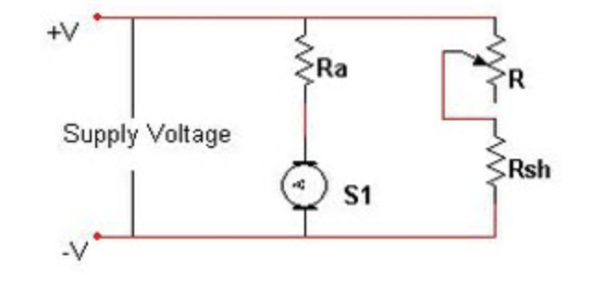

By varying the flux, and by varying the current through field winding (i.e. Flux Control Method )
Φ ∝ I
Φ ∝ $\frac{1}{\text{ω}}$
→ It is efficient as power loss is low due to relatively small current in field winding
Fig.3.2 Flux Control Method
→ Flux Control Method affects commutation
Credit: https://www.elprocus.com/what-are-the-best-ways-to-control-the-speed-of-dc-motor/
→It cannot provide speed control in the desirable range

Slide 10
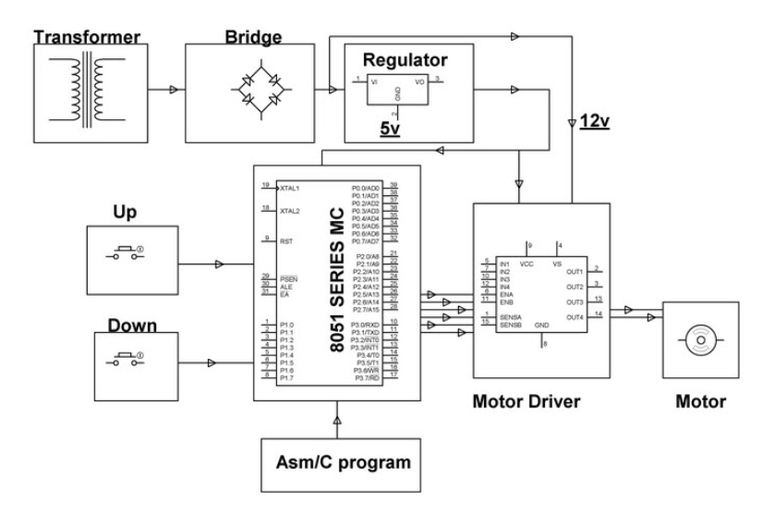
By varying the supplied voltage (i.e. Voltage Control Method)
Fig.3.3 Voltage Control Method using PWM
Credit: https://www.elprocus.com/what-are-the-best-ways-to-control-the-speed-of-dc-motor/

Slide 11
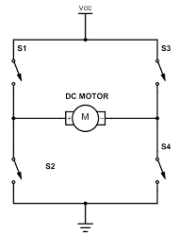
H bridge is used to control the direction of the rotation of the motor
Fig.3.4 Switching direction of current using H bridge
Credit: https://www.build-electronic-circuits.com/h-bridge/

Slide 12
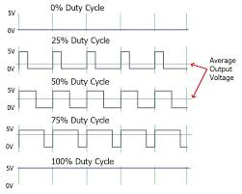
Voltage applied to the motor can be controlled using Pulse Width Modulation
ω ∝ V_{supplied}
Voltage Control Method is very efficient as the power loss is kept at minimum
Specific Voltage applied can be monitored by changing the code
Fig.3.5 PWM signals for different duty cycles
Credit: https://circuitdigest.com/tutorial/what-is-pwm-pulse-width-modulation

Slide 13
Comparison among three methods
Armature Control Method | Flux Control Method | Voltage Control Method
→Huge power loss | →Efficient due to insignificant power loss →Affect commutation →Desirable range of speed control cannot be achieved | →Efficient due to insignificant power loss →Specific voltage can be applied to the motor to control speed →Lower cost

Slide 14

SUMMARY
Armature Control Method
Flux Control Method
Voltage Control Method

Slide 15
REFERENCE
https://www.amazon.com/Small-Electric-DC-Motor-18000/dp/B00NLBXC6E
https://www.amazon.in/Surya-Royale-1200mm-Ceiling-Titanium/dp/B077NJV7HW
https://www.ikea.com/us/en/p/nutid-french-door-refrigerator-stainless-steel-30377925/
https://www.elprocus.com/what-are-the-best-ways-to-control-the-speed-of-dc-motor/
http://workingprincipalofdcmotor.blogspot.com/2013/01/construction-of-dc-motor.html
http://uav.ece.nus.edu.sg/~bmchen/courses/EG1108_DCmotors.pdf
https://www.watelectrical.com/methods-of-speed-control-of-a-dc-motor/
https://www.electricaleasy.com/2014/01/speed-control-methods-of-dc-motor.html
https://www.build-electronic-circuits.com/h-bridge/

Slide 16
THE END
THANK YOU

